Slide 1

SMART PUBLIC TRANSPORT APP
Presented by
- K.BHARATHI
- K.DIVYADHARSHINI
- G.AKSHAYA
- M.INDHUMATHI
- K.SRILATHA

Slide 2
Introduction
Project Name: Smart Public Transport System
Goal: To create an efficient, real-time, and user-friendly mobile application that helps commuters easily locate, plan, and track public transport such as buses, metros, and shared rides.
Role: UX/UI Designer & Researcher
Tools Used: Figma, Adobe XD, Miro, Google Maps API, Illustrator
Duration: 4–6 Weeks

Slide 3
Problem Statement
In most cities, public transport users face uncertainty and inconvenience due to:
  Lack of real-time bus or metro updates
  No accurate route or schedule information
  Difficulty in managing tickets or passes
  Poor communication during delay
The goal of this project is to create a smart app that combines tracking, planning, and digital ticketing to enhance reliability and comfort in everyday travel.

Slide 4
Target Audience / Personas
The app targets:
    Students who use buses and metros daily for college.
    Working professionals who depend on public transport for office commutes.
    Elderly people who need simple, clear route guidance.
    Tourists who are new to the city and need navigation support.
  Each persona shares a common need — easy, quick, and accurate access to public transport details.

Slide 5
User Research
To understand user pain points, surveys and interviews were conducted with frequent commuters.
Findings included:
  Users wait long times at stops due to no live bus information.
  Route confusion when buses are re-routed or delayed.
  Preference for digital payments over cash.
  Desire for a single app to manage all travel needs.
These insights guided the design process toward simplicity and efficiency.

Slide 6
Information Architecture
The app structure was designed to make all key features accessible within 2–3 taps.
Main Sections:
          Home: Live map showing nearby buses and stops.
  Search Route: Enter source and destination to find the best transport options.
  Route Details: List of buses, travel time, stops, and fare details.
  Live Tracking: Real-time map view of the bus or metro in motion.
  Wallet/Tickets: Buy, save, and manage digital tickets or passes.
  Profile: User preferences, travel history, and settings.

Slide 7
User Flow / Journey
Open app → Home screen with live location map
Search source & destination
Choose bus or metro route
View estimated arrival time & stops
Start live tracking for real-time movement
Book and pay for the ticket
Complete the trip and rate experience
This journey ensures end-to-end guidance from planning to completion of travel.

Slide 8
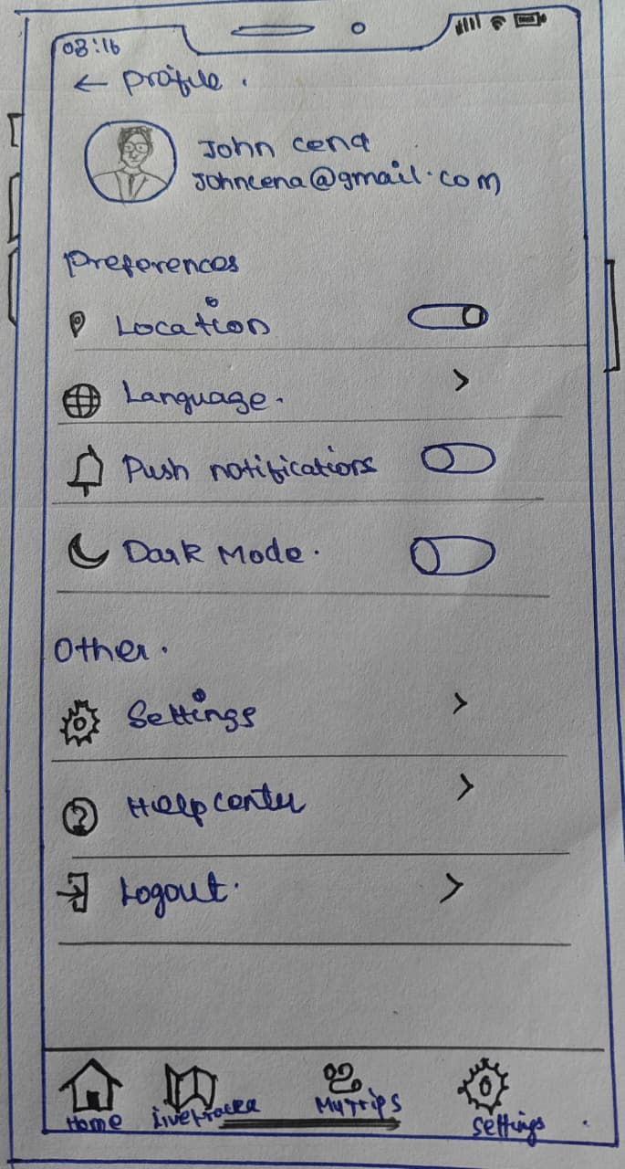
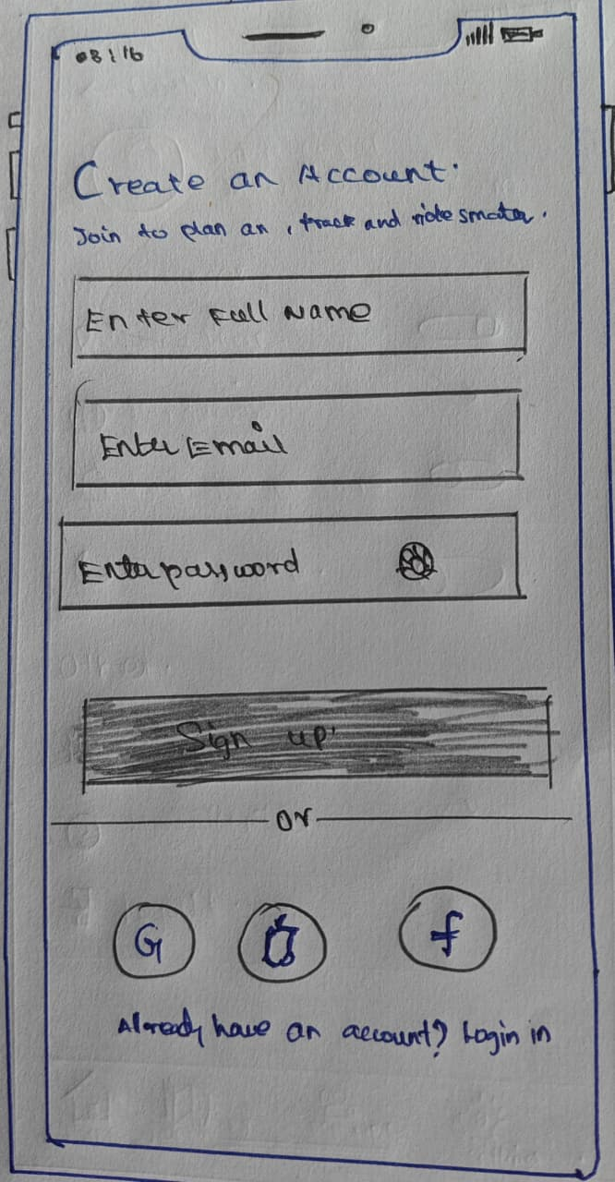
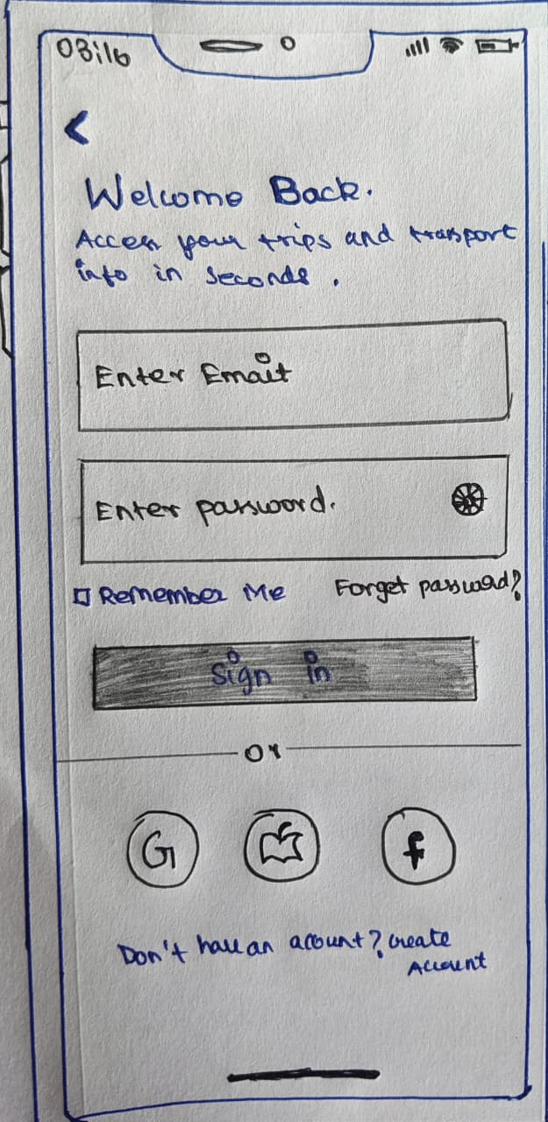
Wireframes (Sketch)

Slide 9
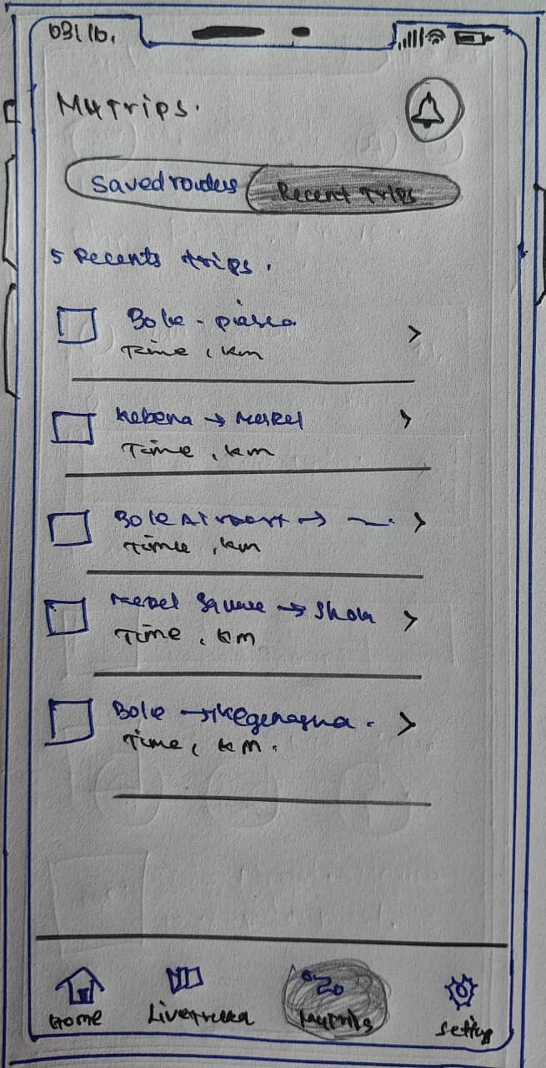
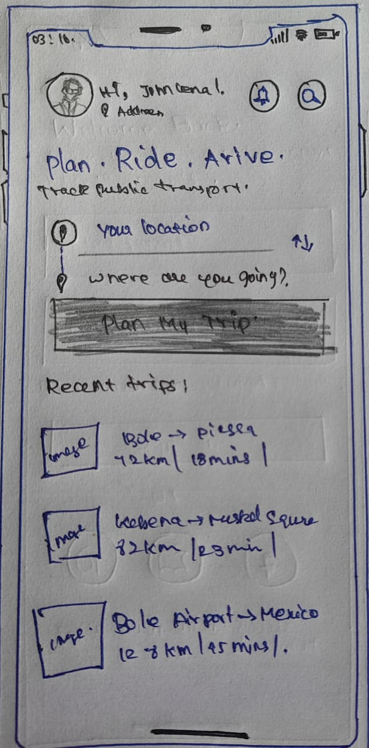
Wireframes (Sketch)

Slide 10
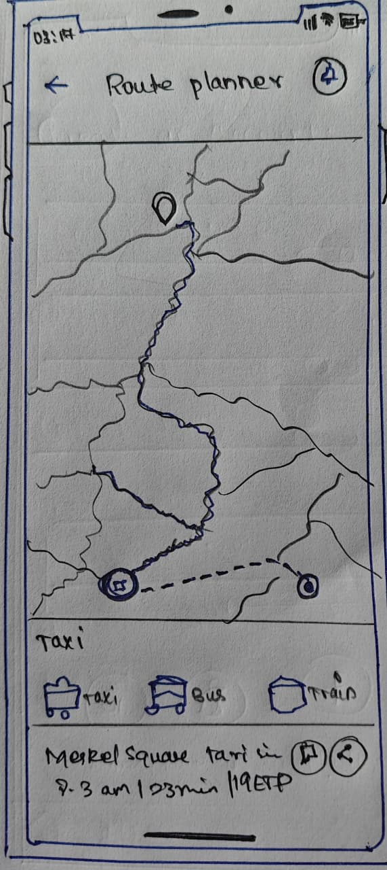
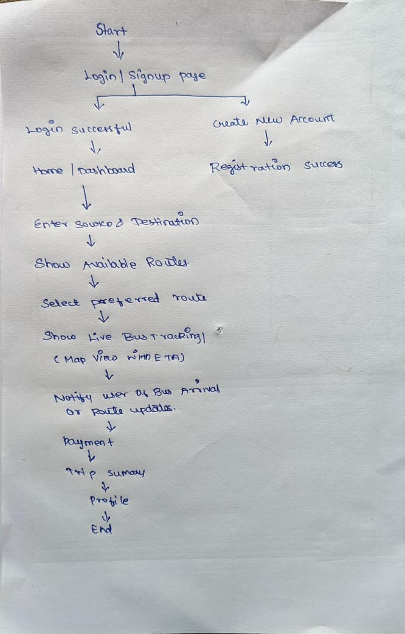
Wireframes (Sketch)

Slide 11
UI Design
The visual design emphasizes simplicity and real-time visibility:
Color Palette: Blue and white for clarity, reliability, and calmness.
Icons: Flat, minimal icons for faster understanding.
Typography: Sans-serif fonts for readability in outdoor use.
Map Interface: Highlighted routes with moving indicators.
Buttons: Rounded and accessible with clear labels.

Slide 12
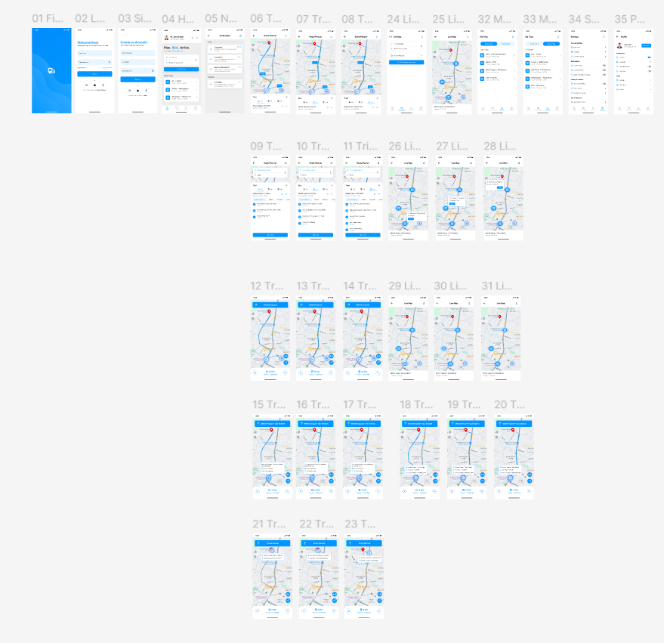
HIGH FIDELITY
FIGMA LINK : https://www.figma.com/design/tcR9oxyvA0deWofGTiKLjN/smart-public-transport-system-app?node-id=0-1&p=f&t=02SM61mEcNcO1Hvg-0

Slide 13
Prototype & Interactions
An interactive prototype was built using Figma, simulating:
Route search
Bus tracking animations
Seat booking & payment
Stop notifications
Micro-interactions like button clicks, route transitions, and alerts enhance usability and provide a real app-like experience.

Slide 14
Usability Testing
The prototype was tested with 10 frequent commuters across different age groups.
Key feedback:
Users appreciated the real-time map updates.
Suggested adding a favorites feature for common routes.
Preferred clear icons over text-heavy buttons.
Requested offline access for saved routes.
These insights were used to refine navigation flow and button placement.

Slide 15
Final Outcome & Impact
After design and testing, the final prototype achieved:
30% reduction in average waiting time by providing accurate live tracking.
Improved travel satisfaction through route transparency.
Increased safety awareness with live sharing of trip details.
Environmental impact: Encouraged more people to use public transport.
The system successfully demonstrated how data and design can improve daily urban travel.

Slide 16
CONCLUSION
The Smart Public Transport App integrates design thinking and technology to make public travel smoother, smarter, and sustainable.
By focusing on real user needs, it enhances comfort, reduces stress, and supports smart city mobility goals.

Slide 17
Thank you…

